Slide 1
Object Oriented Analysis & Design of
Institute of Information & Communication Technology, CUET
Submitted By :
Shafiul Alam (1904006)
Md. Akib Hasan (1904015)
K.M Mahabub Hossain (1904017)
Sadman Rahman Ananta (1904020)
Sawmik Kumar Paul (1904021)
Supervised By:
Prof. Dr. Kaushik Deb
Professor,
Dept of CSE, CUET
Sabiha Anan
Assistant Professor,
Dept of CSE, CUET
Notes:
*

Slide 2
Contents
Introduction
Object-Oriented Analysis & Design
UML
Use Case Diagram
Conclusion

Slide 3
Introduction
Modeling real-world objects with properties and methods that represent the behavior of those objects
How the objects interact with real world
Dynamic behavior of the system of IICT is depicted by a use case diagram

Slide 4
Object-Oriented Analysis & Design
Object-Oriented Analysis and Design known as (OOAD)
Uses object-oriented concepts to design and implement systems
Includes object-oriented programming, design patterns, UML diagrams, and use cases

Slide 5

UML
UML → Unified Modeling Language
  Unified: UML has become a world standard
  Modeling: Describing a software system at a high level of abstraction
  Language: More comprehensible, expressive, ready to use and visualizing.
UML is used for visualizing, specifying , constructing and documenting the components of a system

Slide 6

Use Case Diagram
Illustrates a series of tasks that a system performs with one or more external users (the actors)
Involves actors & use cases
Actors: Represents a user that interacts with the system
Figure 1 : Actor

Slide 7
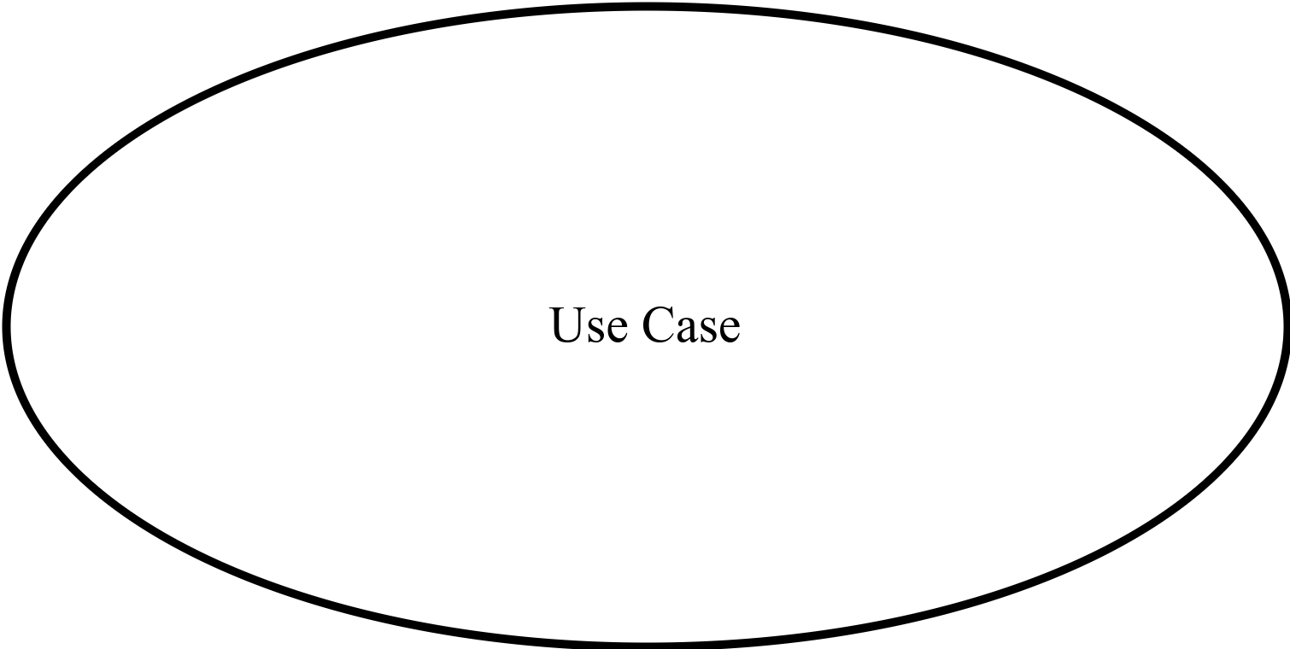
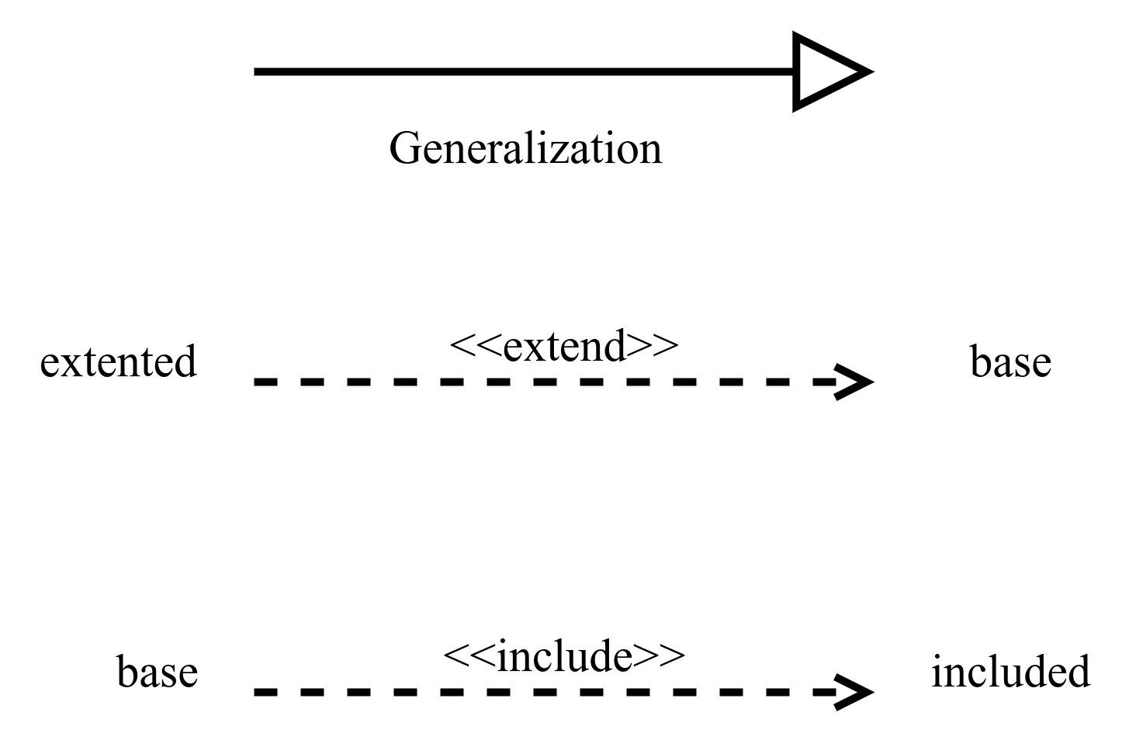
Use Case Diagram(Contd…)
Use Cases: Describes a function that a system performs
Relationships: Connection between model elements
Figure 2 : Use Case
Figure 3 : Relationships

Slide 8
Use Case Diagrams of IICT
Use case diagrams of different sections of IICT:
Course Registration
Email Services
Issuing ID Card
Offered Courses by IICT
Internet Service
Payment System
Surveillance System

Slide 9
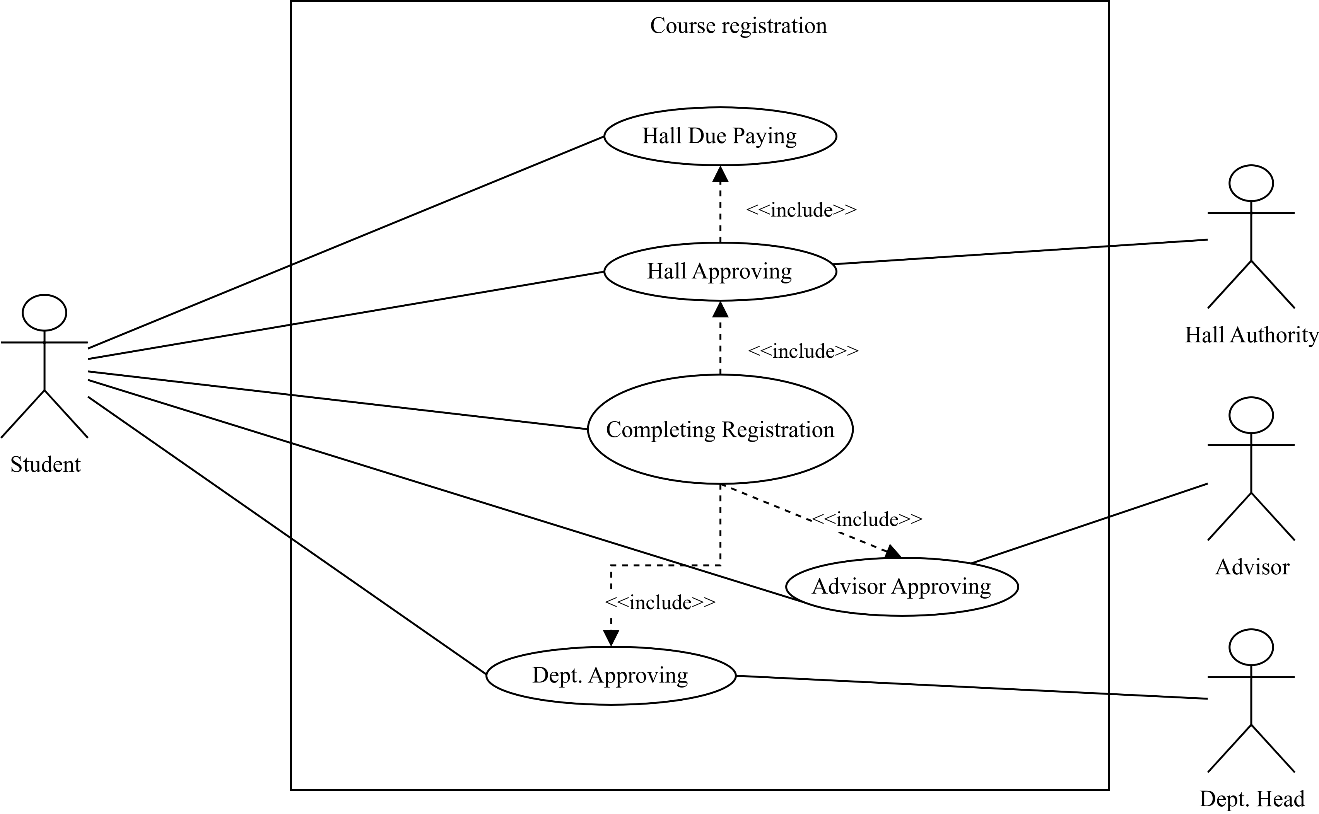
Use Case Diagram for Course Registration
Figure 4 : Use Case Diagram for Course Registration

Slide 10
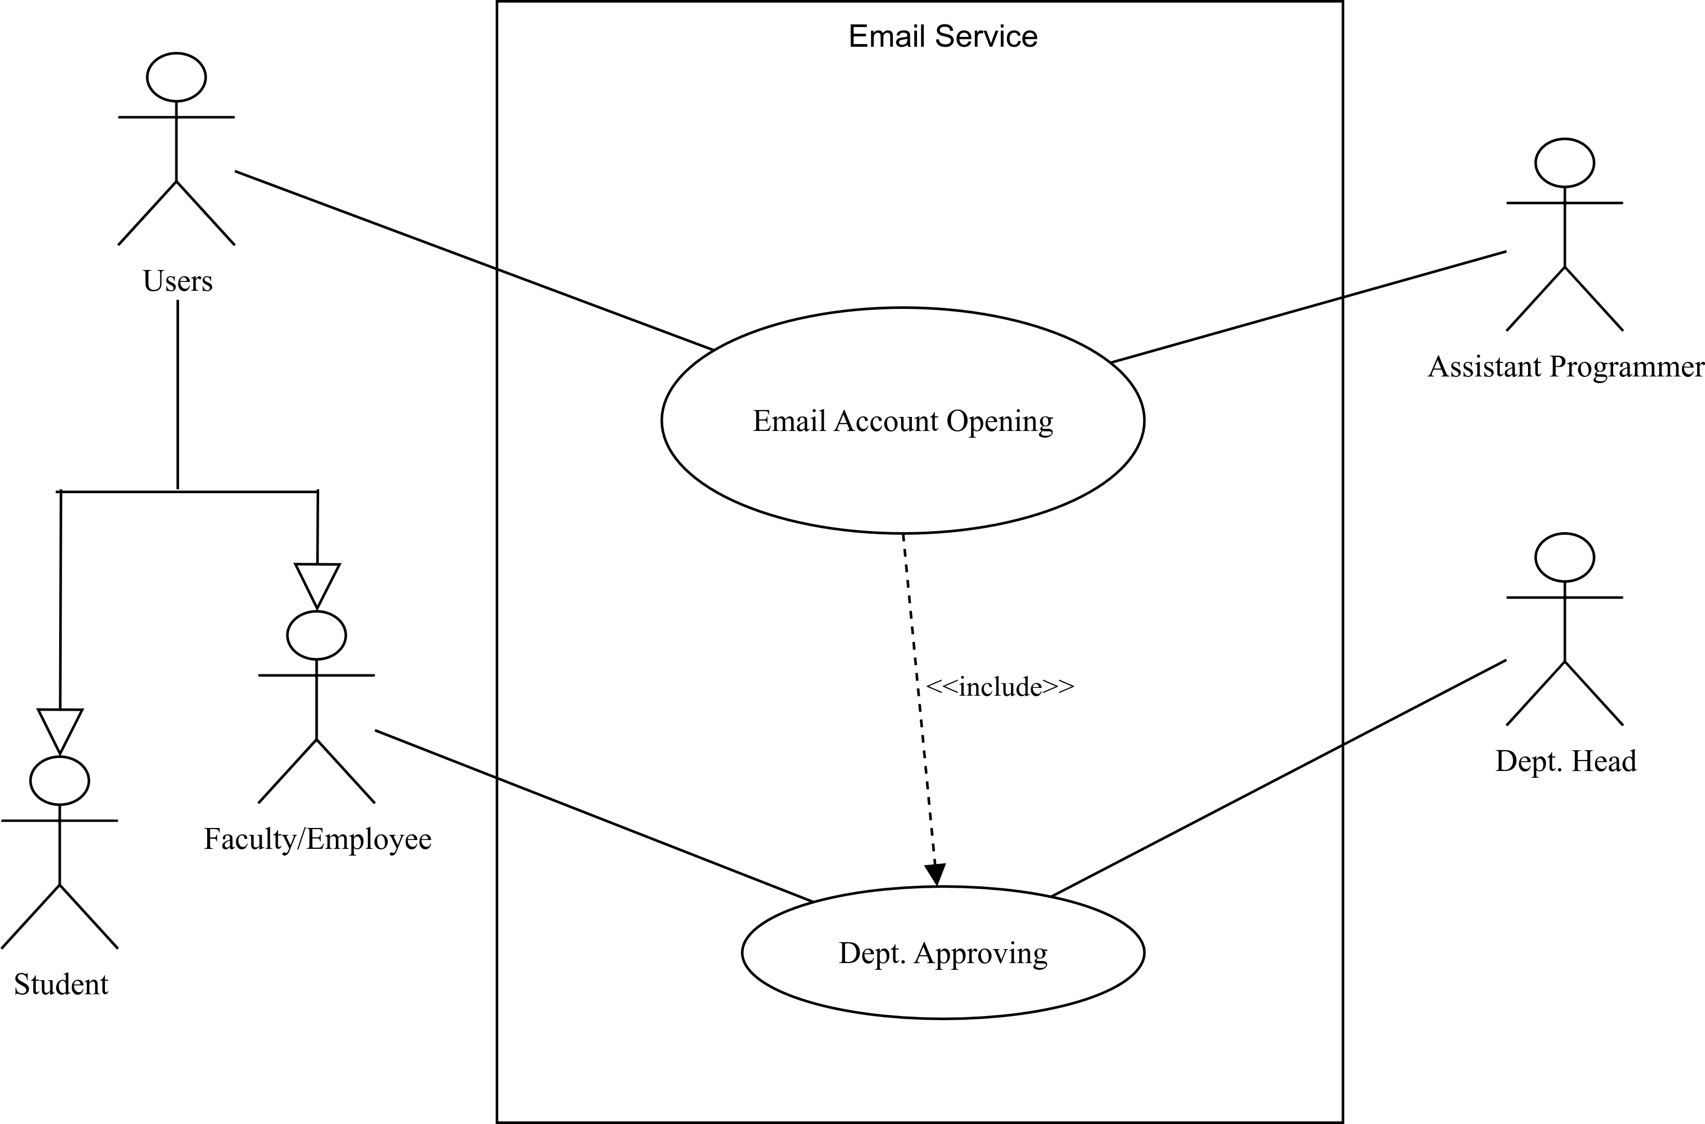
Use Case Diagram for Email Services
Figure 5 : Use Case Diagram for Email Services

Slide 11
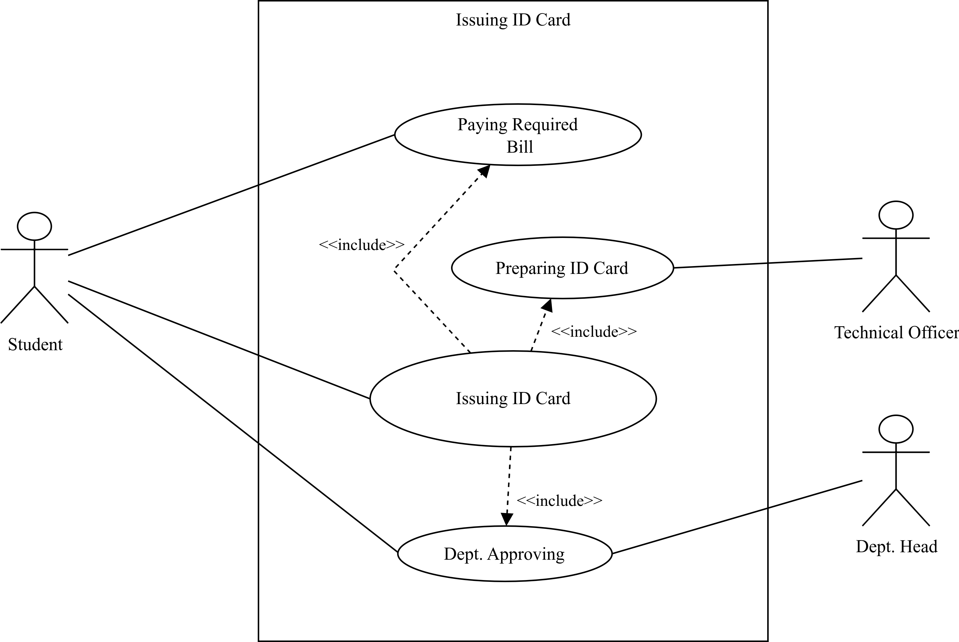
Use Case Diagram for Issuing ID Card
Figure 6 : Use Case Diagram for Issuing ID Card

Slide 12
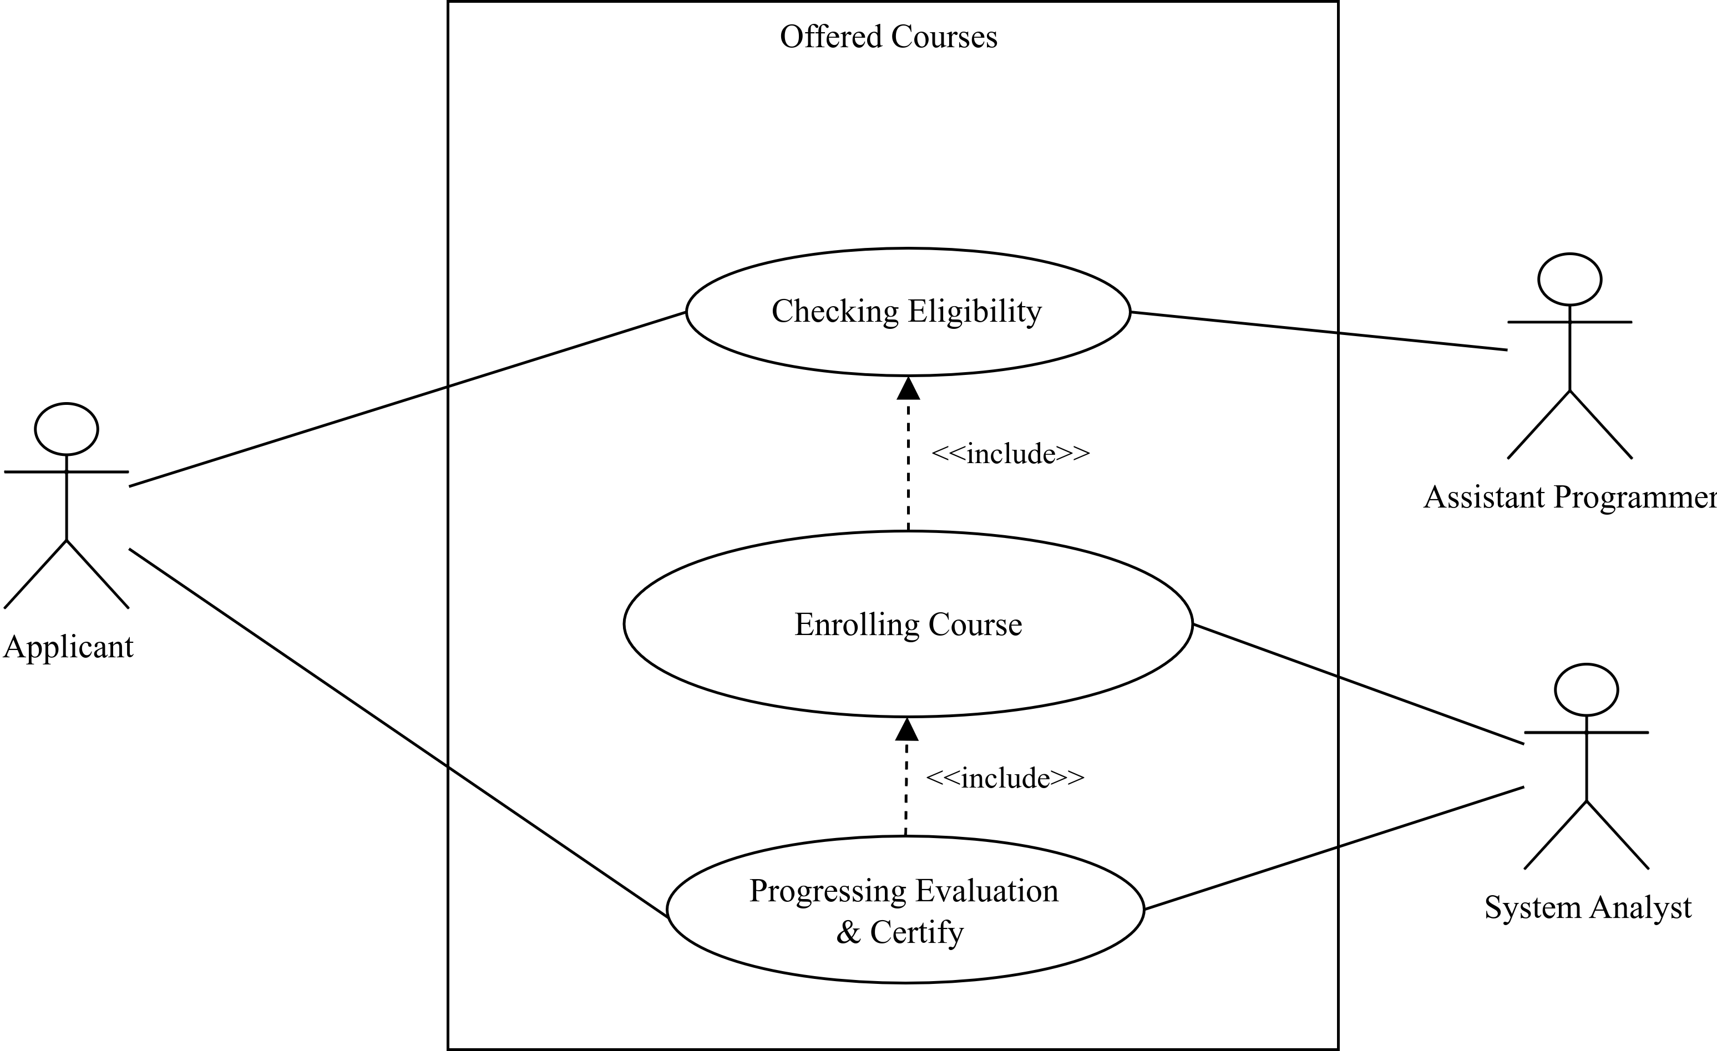
Use Case Diagram for Offered Courses
Figure 7 : Use Case Diagram for Offered Courses

Slide 13
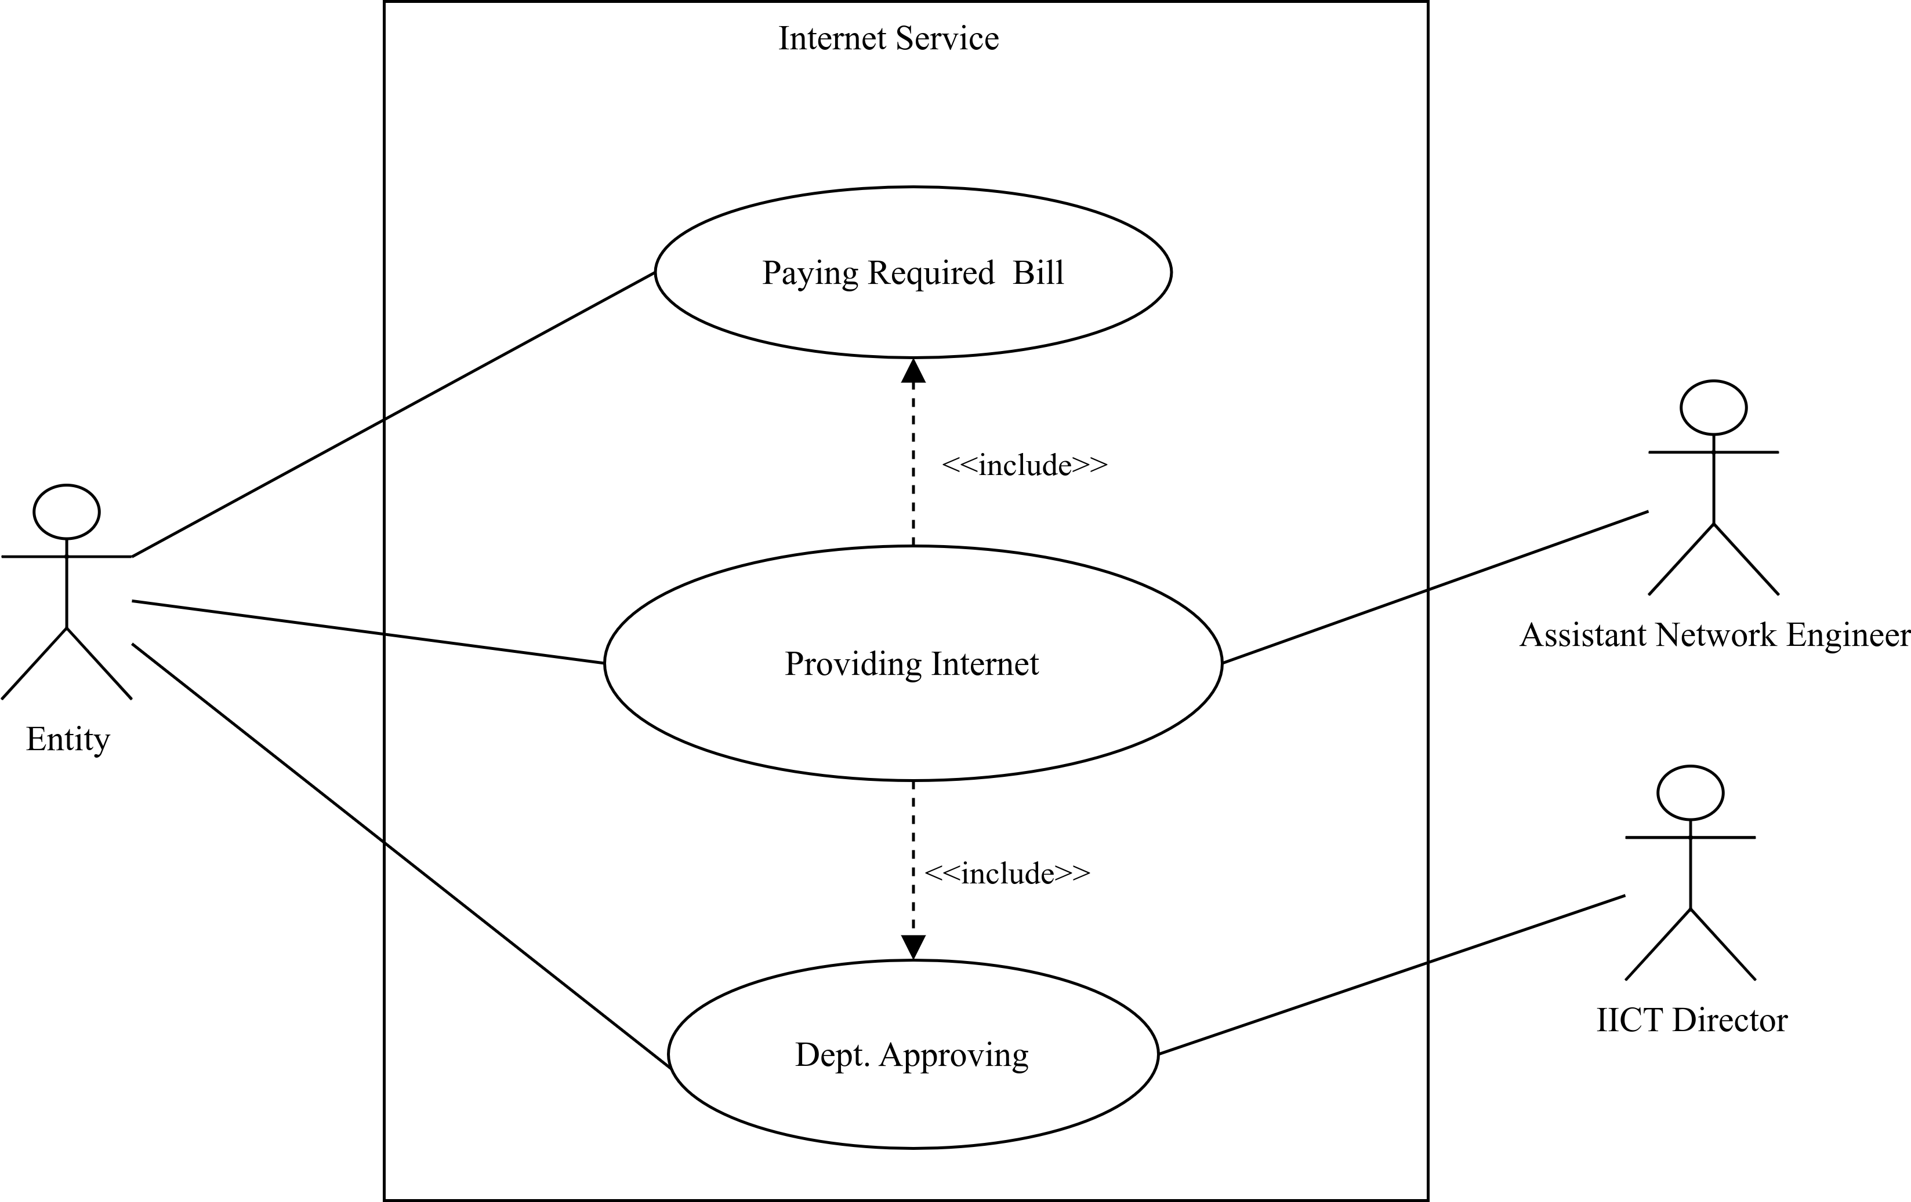
Use Case Diagram for Internet Service
Figure 8: Use Case Diagram for Internet Service

Slide 14
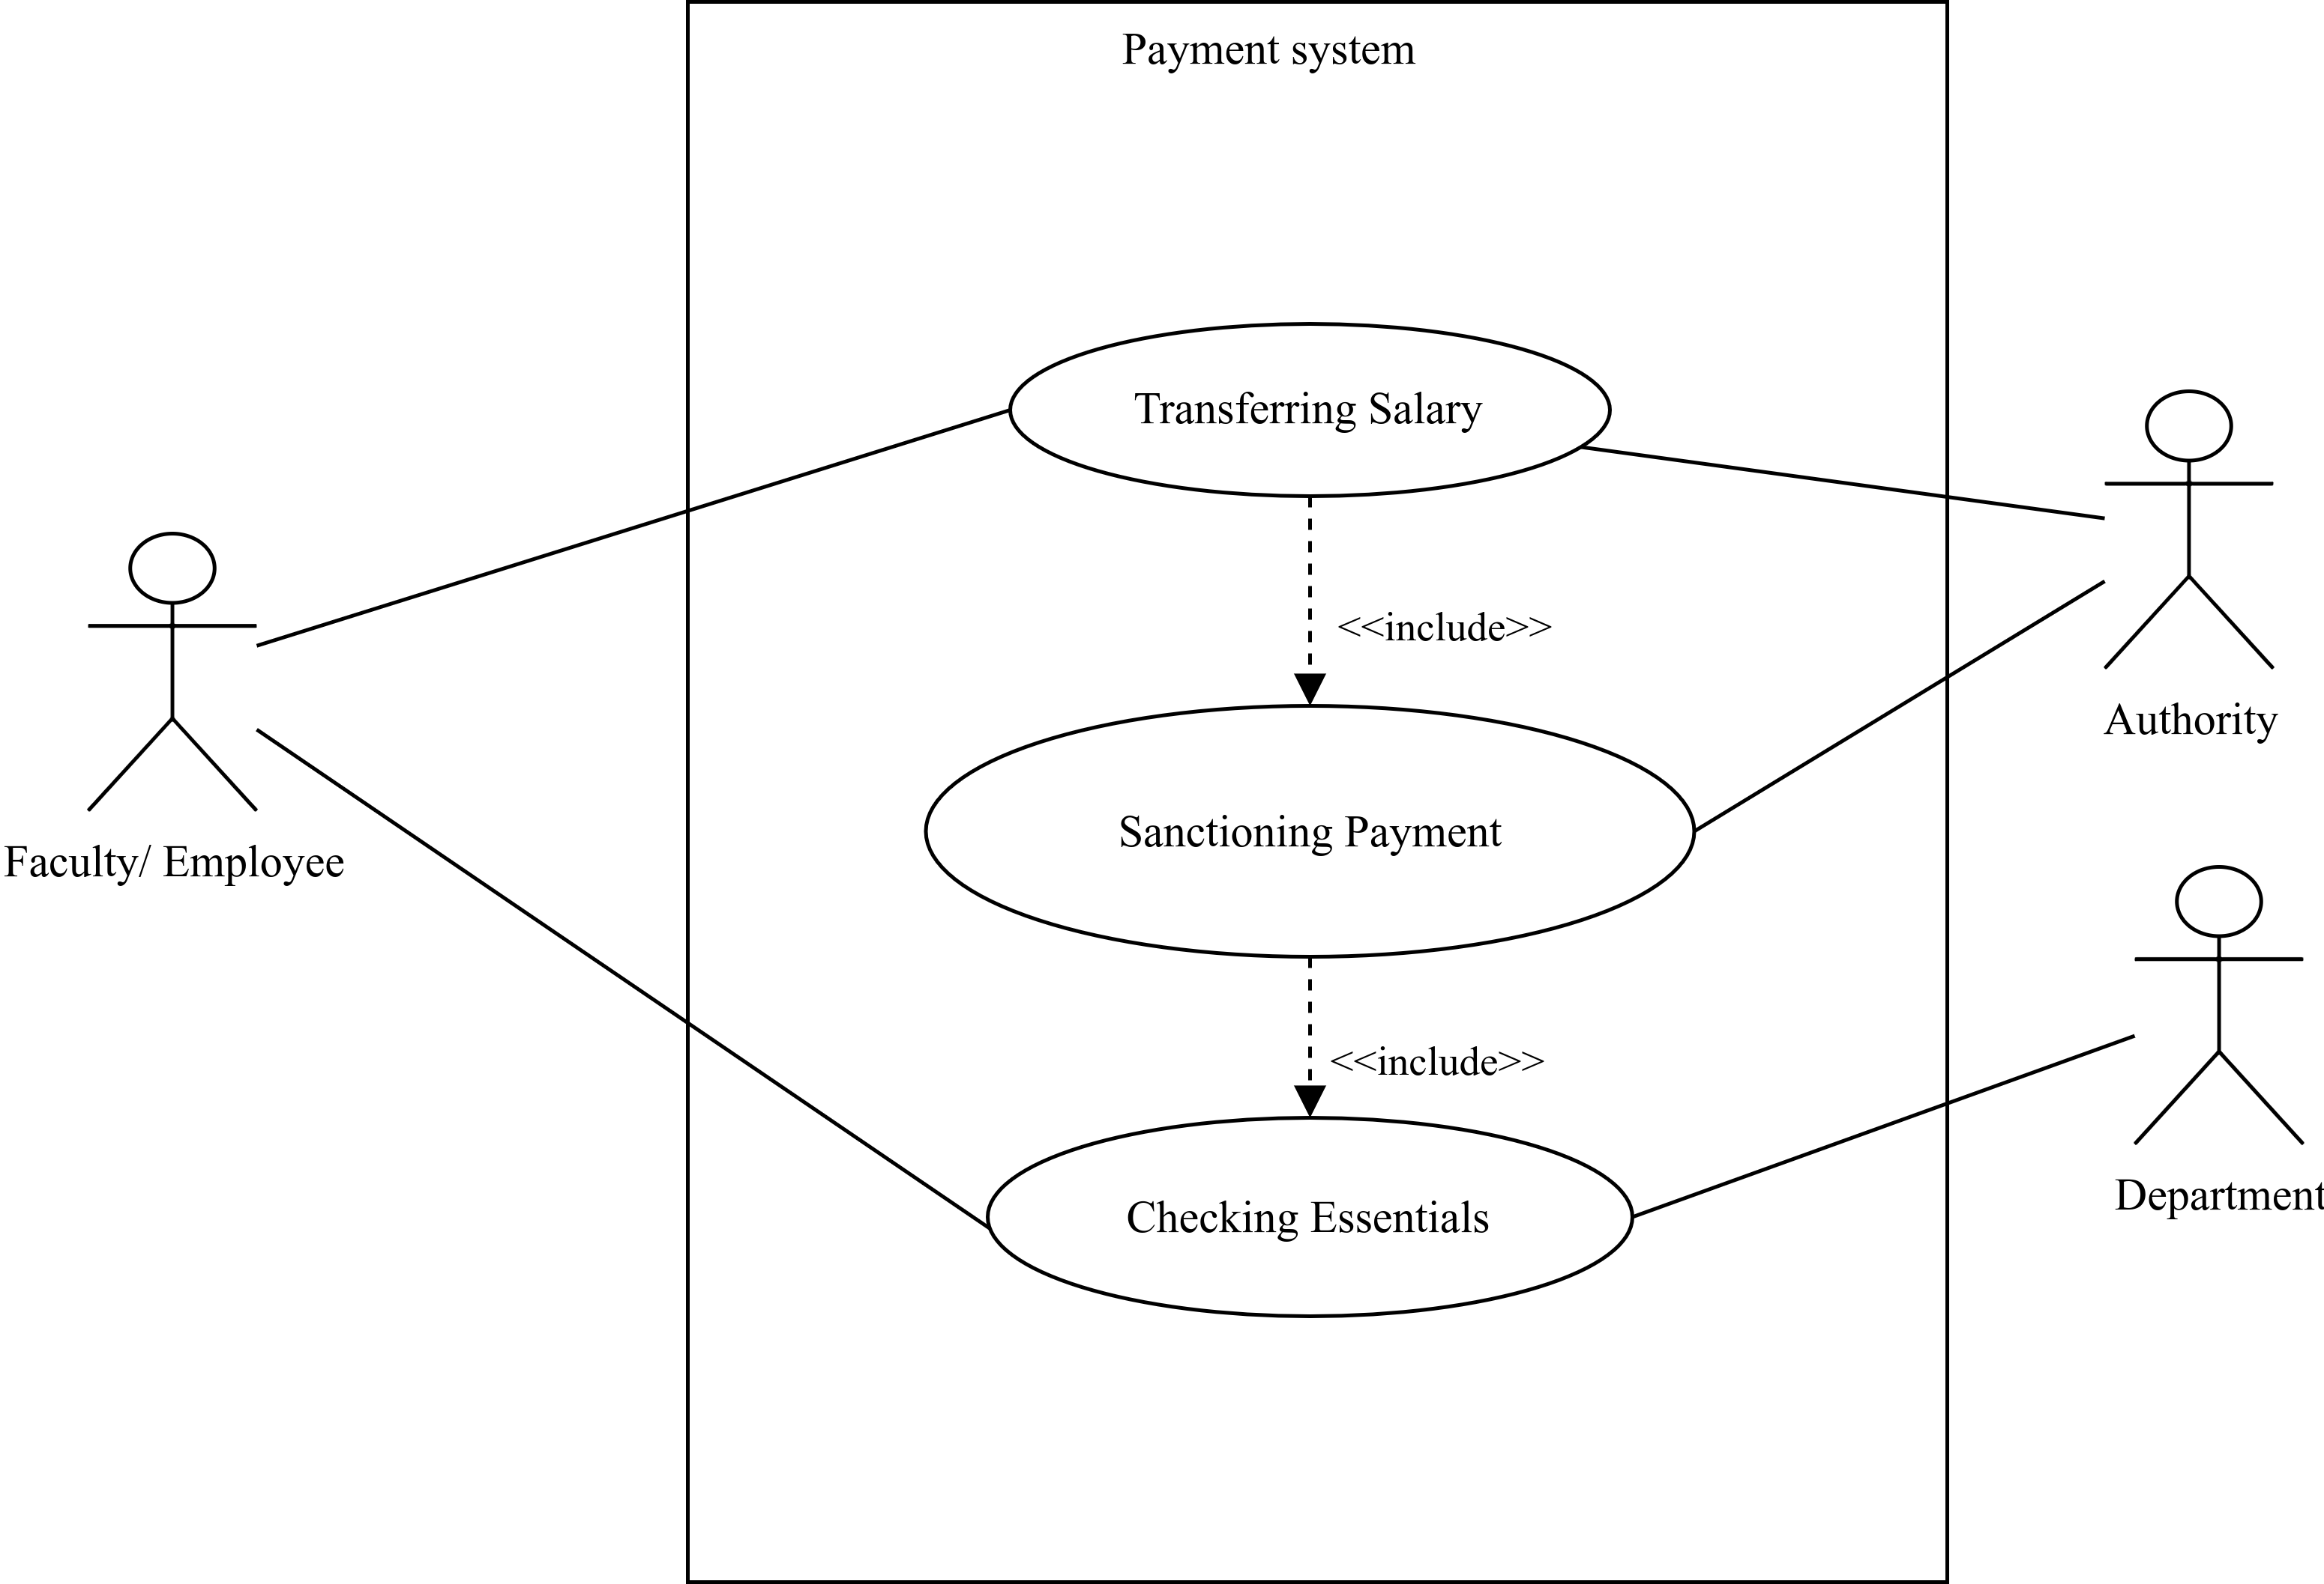
Use Case Diagram for Online Payment System
Figure 9 : Use Case Diagram for Online Payment System

Slide 15
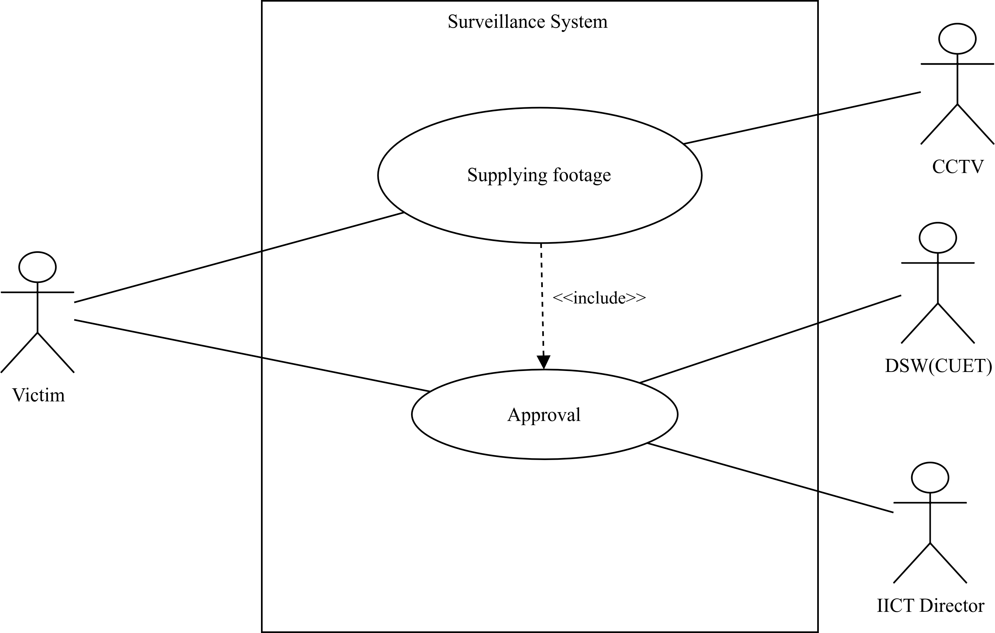
Use Case Diagram for Surveillance System
Figure 10 : Use Case Diagram for Surveillance System

Slide 16
Conclusion
Used use case diagrams to depict various functionalities of systems of IICT
Hardly find any relations in between two sections

Slide 17


